Slide 1
Distributed Classification based on ADMM
CSDS 433 Spring 2021
Randolph Zhao

Slide 2
Introduction

Slide 3
Why Distributed Classification?
The data is too big/slow to be computed by one machine.
Data Stream and Online Apps needs “real-time” response.
The data is too big to be stored in one computer.
In some classification algorithms, loading time is much larger than running time.

Slide 4
Benefits and Difficulties
Benefits:
Parallel data loading and running
Fault tolerance
Difficulties:
Communication
Synchronization

Slide 5
Existing Algorithms

Slide 6
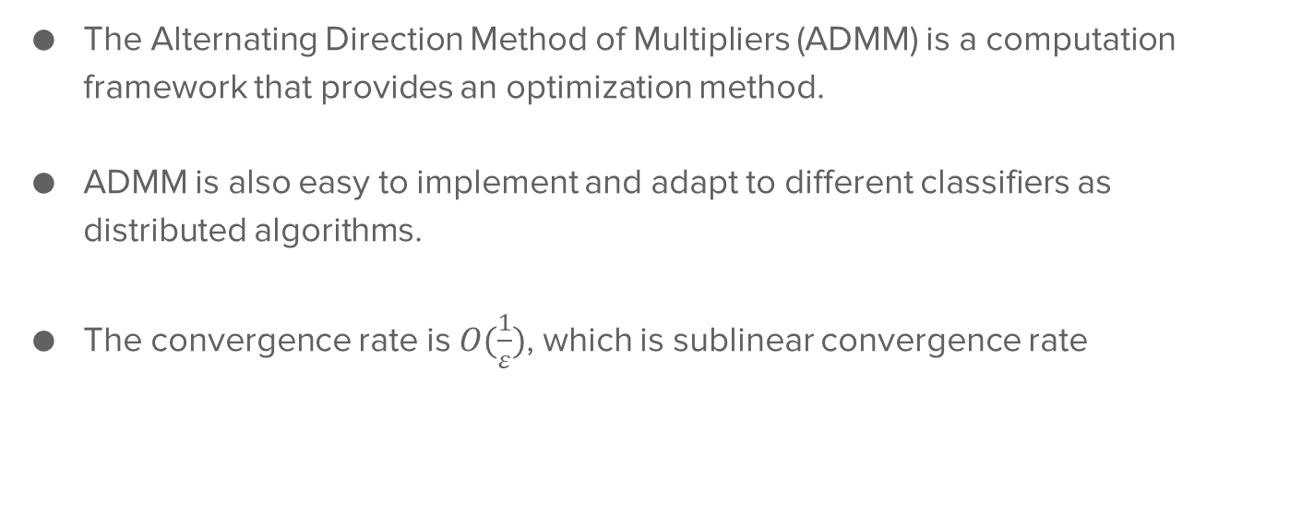
Alternating Direction Method of Multipliers (ADMM)
The Alternating Direction Method of Multipliers (ADMM) is a computation framework that provides an optimization method.
ADMM is also easy to implement and adapt to different classifiers as distributed algorithms.
The convergence rate is $O(\frac{1}{ε})$, which is sublinear convergence rate

Slide 7

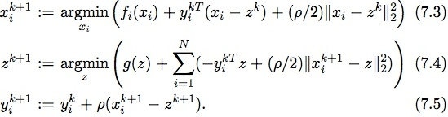
Alternating Direction Method of Multipliers (ADMM)
Given the problem
The steps to solve the problem are
Local
Global

Slide 8
Cost-Sensitive classification algorithm via Group-based ADMM (CS-GADMM)
Solutions for imbalance issues:
Within-node class imbalance
Soft-margin cost-sensitive support vector machine (CSSVM)
Between-node class imbalance
Group machines, update intra-group (Inspired by GADMM)
Between-node structure imbalance
Min-batch extension of DCD (MDCD)

Slide 9
Slow Convergence Problem
Two kinds of solution of convergence problem:
Variance Reduction
SDCA-ADMM
SVRG-ADMM
Nesterov’s Acceleration
A2DM2
D-A2DM2

Slide 10
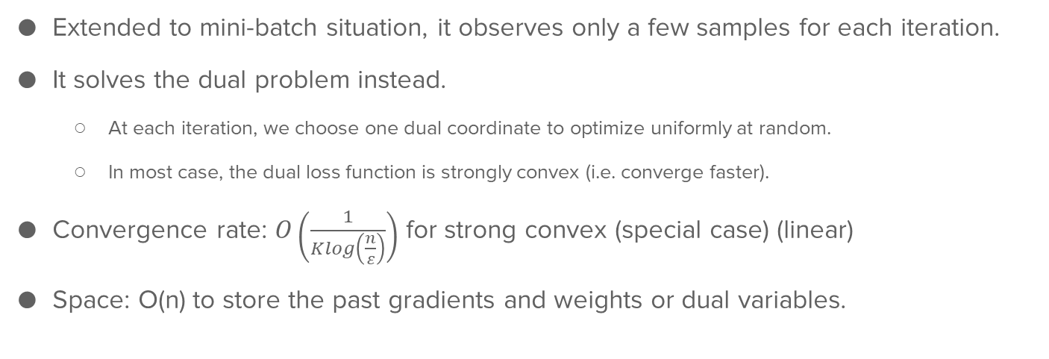
Stochastic Dual Coordinate Ascent with Alternating Direction Method of Multipliers (SDCA-ADMM)
Extended to mini-batch situation, it observes only a few samples for each iteration.
It solves the dual problem instead.
At each iteration, we choose one dual coordinate to optimize uniformly at random.
In most case, the dual loss function is strongly convex (i.e. converge faster).
Convergence rate: $O\left(\frac{1}{Klog\left(\frac{n}{ε}\right)}\right)$ for strong convex (special case) (linear)
Space: O(n) to store the past gradients and weights or dual variables.

Slide 11
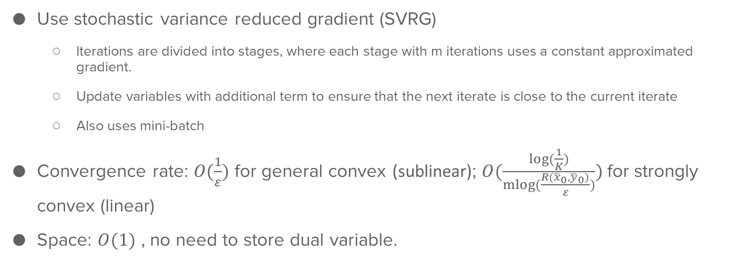
ADMM with the method of stochastic variance reduced gradient (SVRG-ADMM)
Use stochastic variance reduced gradient (SVRG)
Iterations are divided into stages, where each stage with m iterations uses a constant approximated gradient.
Update variables with additional term to ensure that the next iterate is close to the current iterate
Also uses mini-batch
Convergence rate: $O(\frac{1}{ε})$ for general convex (sublinear); $O(\frac{log⁡(\frac{1}{K})}{mlog⁡(\frac{R({\overline{x}}_{0},{\overline{y}}_{0})}{ε})})$ for strongly convex (linear)
Space: $O(1)$ , no need to store dual variable.

Slide 12

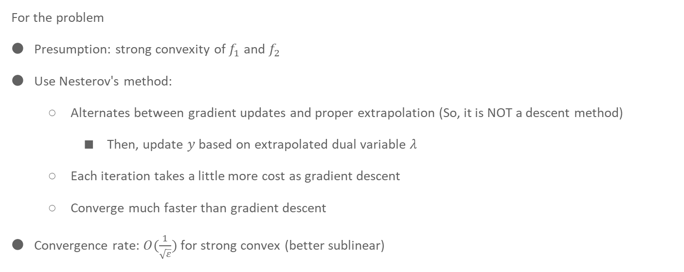
Accelerated Alternating Direction Method of Multipliers (A2DM2)
For the problem
Presumption: strong convexity of $f_{1}$ and $f_{2}$
Use Nesterov's method:
Alternates between gradient updates and proper extrapolation (So, it is NOT a descent method)
Then, update $y$ based on extrapolated dual variable $λ$
Each iteration takes a little more cost as gradient descent
Converge much faster than gradient descent
Convergence rate: $O(\frac{1}{\sqrt{ε}})$ for strong convex (better sublinear)

Slide 13
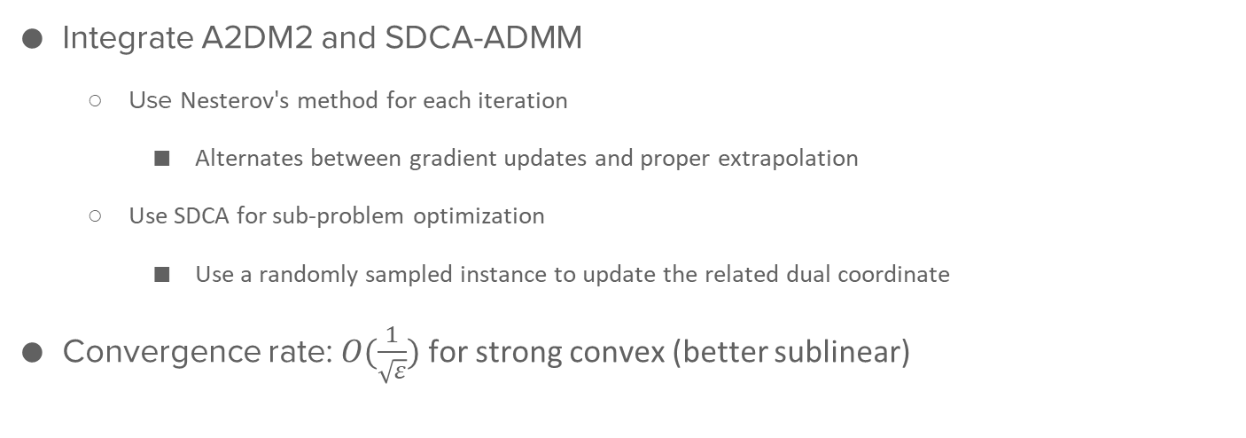
Distributed Accelerated Alternating Direction Method of Multipliers (D-A2DM2)
Integrate A2DM2 and SDCA-ADMM
Use Nesterov's method for each iteration
Alternates between gradient updates and proper extrapolation
Use SDCA for sub-problem optimization
Use a randomly sampled instance to update the related dual coordinate
Convergence rate: $O(\frac{1}{\sqrt{ε}})$ for strong convex (better sublinear)

Slide 14
Comparisons

Slide 15
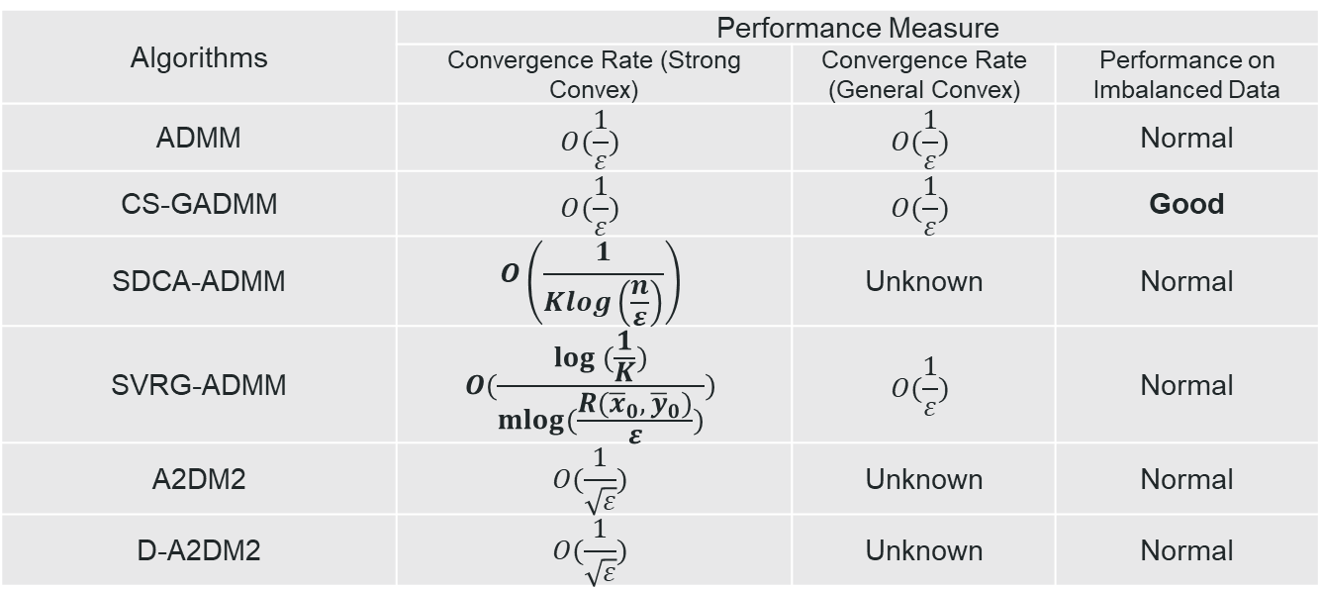
Comparison
Algorithms | Performance Measure
 | Convergence Rate (Strong Convex) | Convergence Rate (General Convex) | Performance on Imbalanced Data
ADMM | $$O(\frac{1}{ε})$$ | $$O(\frac{1}{ε})$$ | Normal
CS-GADMM | $$O(\frac{1}{ε})$$ | $$O(\frac{1}{ε})$$ | Good
SDCA-ADMM | $$O\left(\frac{1}{Klog\left(\frac{n}{ε}\right)}\right)$$ | Unknown | Normal
SVRG-ADMM | $$O(\frac{log (\frac{1}{K})}{mlog(\frac{R({\overline{x}}_{0},{\overline{y}}_{0})}{ε})})$$ | $$O(\frac{1}{ε})$$ | Normal
A2DM2 | $$O(\frac{1}{\sqrt{ε}})$$ | Unknown | Normal
D-A2DM2 | $$O(\frac{1}{\sqrt{ε}})$$ | Unknown | Normal

Slide 16
Conclusion

Slide 17
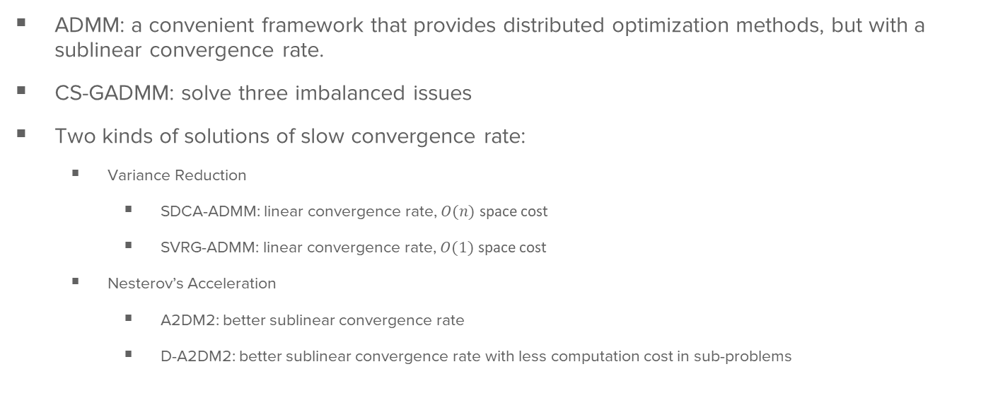
Conclusion
ADMM: a convenient framework that provides distributed optimization methods, but with a sublinear convergence rate.
CS-GADMM: solve three imbalanced issues
Two kinds of solutions of slow convergence rate:
Variance Reduction
SDCA-ADMM: linear convergence rate, $O(n)$ space cost
SVRG-ADMM: linear convergence rate, $O(1)$ space cost
Nesterov’s Acceleration
A2DM2: better sublinear convergence rate
D-A2DM2: better sublinear convergence rate with less computation cost in sub-problems

Slide 18
Potential Improvements
Fault Tolerance Mechanism
Set idle workers to continue computing if one fails. Set “checking point” when getting consensus.
Reduce Communication Cost
Locally update all variable for a decreasing constant of iterations and then communicate and get a consensus
Hierarchically Group-Based ADMM
Group workers in a tree-like structure and get a consensus hierarchically.

Slide 19
Any Questions?

Slide 20
Thank you for listening!

